Slide 1
ENVIRONMENTAL POLLUTION
By
ShaRIAR HOSSEN SABBIR
Student of geography and environment, sust

Slide 2
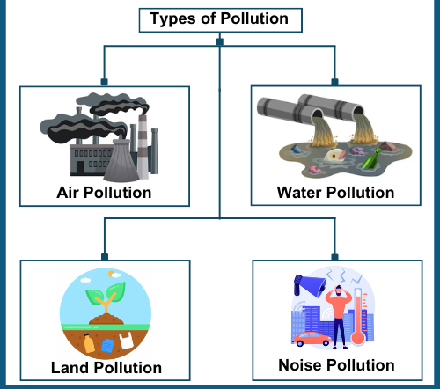
What Is Environmental Pollution?
Definition: Introduction to environmental pollution as the contamination of natural resources by harmful substances.
Types of Pollution
Air Pollution
Water Pollution
Soil Pollution
Noise Pollution

Slide 3
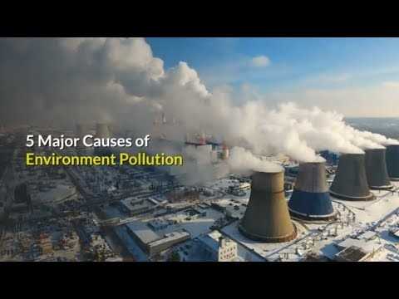
Causes of Pollution
Human Activities:
Industrial Emissions
Deforestation
Plastic Waste and Improper Disposal
Natural Causes:
Volcanic Eruptions
Wildfires

Slide 4
Effects on Human Health and Ecosystems
Health Impacts:
Diseases like asthma, cancer, and cardiovascular issues
Waterborne illnesses and food contamination
Ecosystem Impacts:
Loss of biodiversity
Disruption of food chains
Global Challenges
Climate Change: Linked to air and water pollution
Plastic Waste Crisis: Overwhelming landfills and oceans
Urbanization: Overcrowding and strain on natural resources

Slide 5
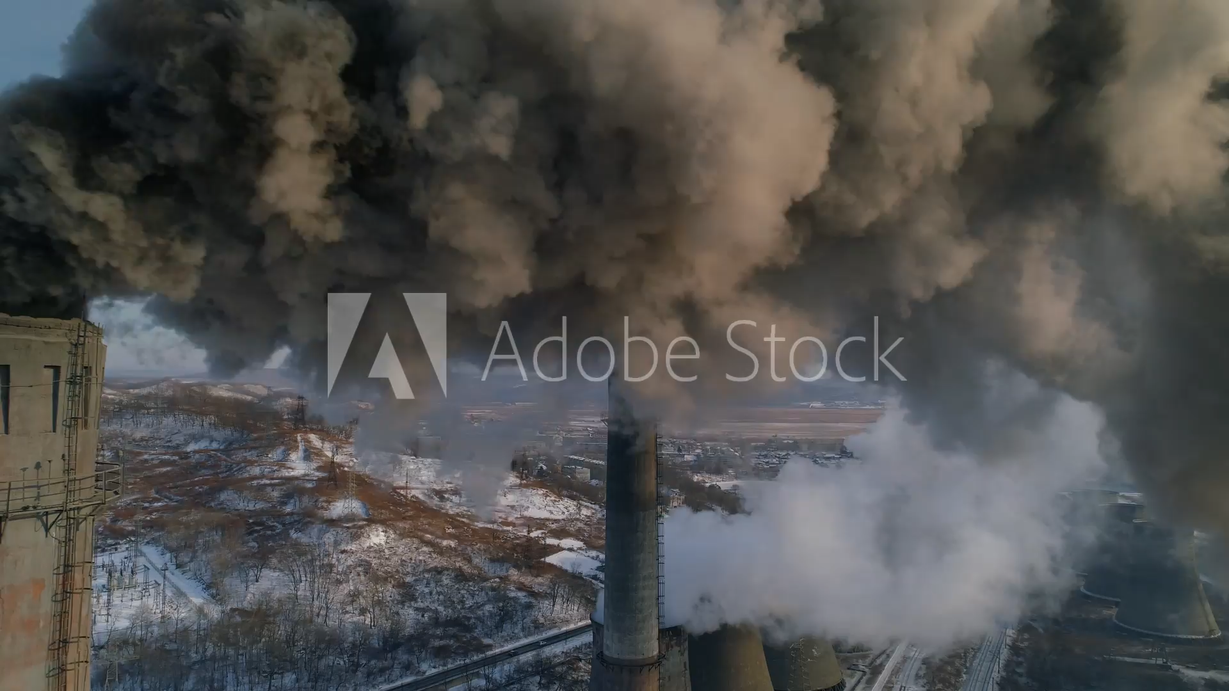
ANY
QUESTIONS

